Slide 1
Computer Organization
Part 10: Floating Point Arithmetics
UNIT – I

Slide 2
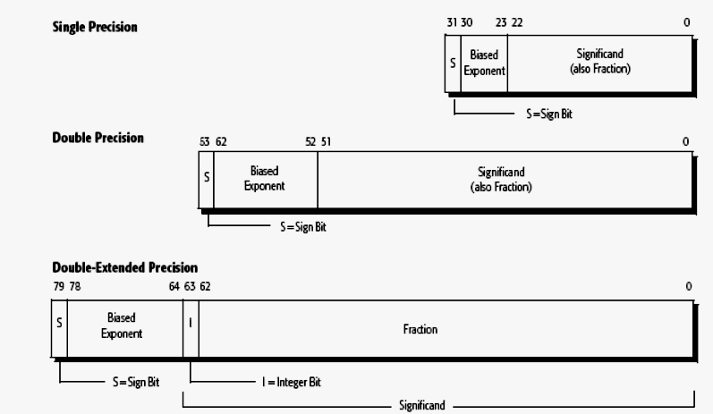
IEEE floating point numbers
Institution of Electrical and Electronic Engineers

Slide 3
Floating Point
15900000000000000
could be represented as
14
Mantissa
Exponent
159 * 10¹⁴
15.9 * 10¹⁵
1.59 * 10¹⁶
A calculator might display 159 E14
Notes:
When we deal with very large and very small numbers we often resort to using scientific notation.
Calculators, for example, often represent the results of large calculations this way because there is an insufficient number of digits to show the result normally
159 is called the mantissa 14 the exponent which is the number of places to move the decimal point.

Slide 4
Binary Fractions
The value of real binary numbers…
Scientific | 2² | 2¹ | 2⁰ | . | 2⁻¹ | 2⁻² | 2⁻³
Fractions |  |  |  | . | ½ | ¼ | ¾
Decimal | 4 | 2 | 1 | . | .5 | .25 | .125
1 0 1 . 1 0 1

Slide 5
Binary Fractions
The value of real binary numbers…
Scientific | 2² | 2¹ | 2⁰ | . | 2⁻¹ | 2⁻² | 2⁻³
Fractions |  |  |  | . | ½ | ¼ | ⅛
Decimal | 4 | 2 | 1 | . | .5 | .25 | .125
1 0 1 . 1 0 1

Slide 6
Binary Fractions
The value of real binary numbers…
Scientific | 2² | 2¹ | 2⁰ | . | 2⁻¹ | 2⁻² | 2⁻³
Fractions |  |  |  | . | ½ | ¼ | ⅛
Decimal | 4 | 2 | 1 | . | .5 | .25 | .125
1 0 1 . 1 0 1
101.101 = 4+1+1/2+1/8
= 4+1+.5+.125= 5.625
= 5 ⅝

Slide 7
IEEE Single Precision
The number will occupy 32 bits
  The first bit represents the sign of the number;
  1= negative 0= positive.
  The next 8 bits will specify the exponent stored in biased 127 form.
  The remaining 23 bits will carry the mantissa normalised to be between 1 and 2.
  i.e. 1<= mantissa < 2

Slide 8
Basic Conversion
Converting a decimal number to a floating point number.
1. Take the integer part of the number and generate the binary equivalent.
2. Take the fractional part and generate a binary fraction
3. Then place the two parts together and normalise.

Slide 9
IEEE – Example 1
Convert 6.75 to 32 bit IEEE format.
1. The Mantissa. The Integer first.
6 / 2 = 3 r 0
3 / 2 = 1 r 1
1 / 2 = 0 r 1
2. Fraction next.
.75 * 2 = 1.5
= 110₂
= 0.11₂

Slide 10
IEEE – Example 1
Convert 6.75 to 32 bit IEEE format.
1. The Mantissa. The Integer first.
6 / 2 = 3 r 0
3 / 2 = 1 r 1
1 / 2 = 0 r 1
= 110₂

Slide 11
IEEE – Example 1
Convert 6.75 to 32 bit IEEE format.
1. The Mantissa. The Integer first.
6 / 2 = 3 r 0
3 / 2 = 1 r 1
1 / 2 = 0 r 1
2. Fraction next.
.75 * 2 = 1.5
.5 * 2 = 1.0
3. put the two parts together… 110.11
Now normalise 1.1011 * 2²
= 110₂
= 0.11₂

Slide 12
IEEE Biased 127 Exponent
To generate a biased 127 exponent
Take the value of the signed exponent and add 127.
Example.
2¹⁶ then 2¹²⁷⁺¹⁶ = 2¹⁴³ and my value for the exponent would be 143 = 10001111₂
So it is simply now an unsigned value ....

Slide 13
Example:
Represent the 1259.125 in single and double precision format:
Convert 1259 to binary…
  i.e. 10011101011
Fractional part…
  0.125 × 2 = 0.25 0
  0.25 × 2 = 0.5 0
  0.5 × 3 = 1.0 1

Slide 14
Normalize the number:
  10011101011.001 = 1.0011101011001 × 2¹⁰
Single precision representation
  S = 0, E = 10, M = 0011101011001
  Bias for single precision is 127
  So, E’ = E + 127 = 10 + 127 = 137₁₀ = 10001001₂
Now the number format is
  0 10001001 00111010110010000000000
Sign
Exponent
Mantissa

Slide 15
Normalize the number:
  10011101011.001 = 1.0011101011001 × 2¹⁰
Double precision representation
  S = 0, E = 10, M = 0011101011001
  Bias for single precision is 1023
  So, E’ = E + 1023 = 10 + 1023 = 1033₁₀
  = 10000001001₂
Now the number format is
  0 10001001 0011101011001000……..00
Sign
Exponent
Mantissa 32-bits

Slide 16
Exceptions
Underflow
Overflow
Divide by zero
Inexact
Invalid

Slide 17
Floating point addition
Example: Add A = 44900000H, B = 42A00000H
Represent them in single precision:
  A = 0 1000 1001 0010 000……0
  B = 0 1000 0101 0100 000……0
  Exponent for A = 1000 1001 = 137
  So at actual, exponent = 137 – 127 = 10
  Exponent for B = 1000 0101 = 133
  So at actual, exponent = 133 – 127 = 6

Slide 18
Shift mantissas
  As B has smaller exponent with difference 4. hence the mantissa is shifted right by 4 bits as,
  So, B = 00000100……0
Add mantissas
  A = 00100000……0
  B = 00000100……0
  Result 00100100……0
So, final result is
0 10001001 0010010000…..0

Slide 19
Flowcharts
Flowchart: Floating point addition
Flowchart: Floating point multiplication
Flowchart: Floating point division

Slide 20
Guard Bits and Truncation
Guard Bits
Truncation
  Chopping
  Von-neumann rounding
  Rounding

Slide 21
Reference
Computer Organization, Designing for Performance by William Stallings
Computer Organization, by Atul Godse

